Slide 1
Demo Project Flow
Computer Vision & Image Processing Based

Slide 2
Vision - Circle Recognition
Using solely computer vision and image processing:
HoughCircles (example: Detecting Circles in Images using OpenCV and Hough Circles - PyImageSearch)
Watershed
Tests for:
Different parameters and threshold for better and accurate circle detection
Defect circles
Is there a need to add any object detection pipeline?

Slide 3
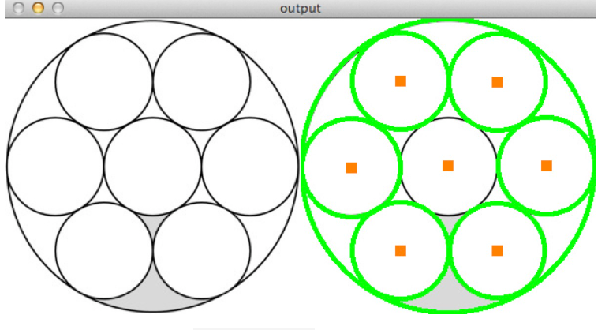
Vision - Steps
Writing a script based on one of the mentioned methods
Further testing and additional processing to better circle detection.
Defining some sort of “not perfect circles” within the script
Customize the code to change colors depending on circles or defects.
Testing the script for any defected circles and change the detection to red

Slide 4
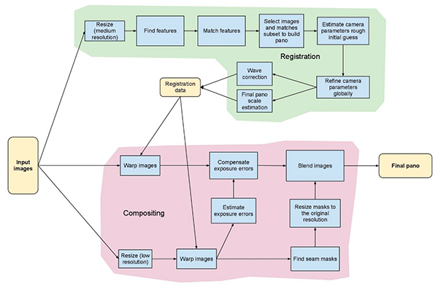
Vision & SW
Image stitching and mapping

Slide 5
SW - UI steps
Amin’s section to add more steps for UI feature addition and/or testing
Putting the camera feed into a thread
Data logging
Adding more features for better looks
Stretching window
Etc
SW update process

Slide 6
Communication between camera & SW front-end
Camera live view (snips or video)
While Camera live view an option to turn “Inspection” on
Choosing an Inspection type from “Inspection” bar (e.g. circle detection, surface inspection, defects area - ROIs)
Begin process button
When there’s any type of defects create an alert / Visual alert
Save the data (refer to Data logging) - pop windows to let the user know data’s been saved
Additional button to start the process from beginning etc etc - less important
Data logging: when the inspection process begins data logs in a e.g. SQL form
SQL should have e.g. product serial number, columns for inspection types (being able to give value to the column), date & timestamps
Data communication - maybe later

Slide 7
Communication between CV/AI + SW backend
Integrate a script with the provided CV/AI python file
Running the image through e.g. py file
Function / method availability for SW backend
Creating exe files
Data pipeline - later

